Slide 1
Presentation on…..
Hotel Management System.

Slide 2
MYSELF
MD. EVAN KHAN EMON
ID: UG02-47-18-009
Dept. Of CSE

Slide 3
Introduction.
Hotel management is really about overseeing every operation of the property. This requires knowledge of distribution strategy, finance, customer service, staff management, marketing, and more.In no way should any of these be treated as ‘set and forget’. Hotel management is about constantly evaluating performance is every facet of the business and making necessary adjustments.

Slide 4
REQUIREMENTS:
PHP
HTML
CSS
MYSQL FOR THE DATABASE
XAMPP

Slide 5
PROJECT SUMMARY
"HOTEL Management System" has been designed to computerize the
following functions that are performed by the system:
Room Detail Functions
Opening a New Room
Modification to Room assigned
Check-in and check-out Functions
Sign-up of New customer
Room assigning related to customer's need
Statement of customer Details
Room Details
Individual customer Report.

Slide 6
System facilities
Booking a room online add up long before guest's arrival.
Guests can read reviews and compare prices for Online Room Booking.
The most important advantage of online room booking is convenience.
Internet helps people to browse through the hotels around the world and compare the facilities and rates easily.

Slide 7
External Interfaces
This interface will be actual interface through which the user will communication with the
application and perform the desired tasks.
Admin login
I.D:
Role: Admin wishes to login to the system
Precondition: Username and Password
Success end Condition: Main option of screen display
Failed end Condition: User has entered incorrect Username and
Password or both

Slide 8
Software Product Features
Hotel Management System
Sequencing information
-Login information should be filled before the user allowed.
Error Handling
-If user doesn’t filled up validate information then the system display error message for
user and request to enter the validate information.
Performance required Security
-System should be Protected from unauthorized access Where the validate Username
and Password are required so no other can access.

Slide 9
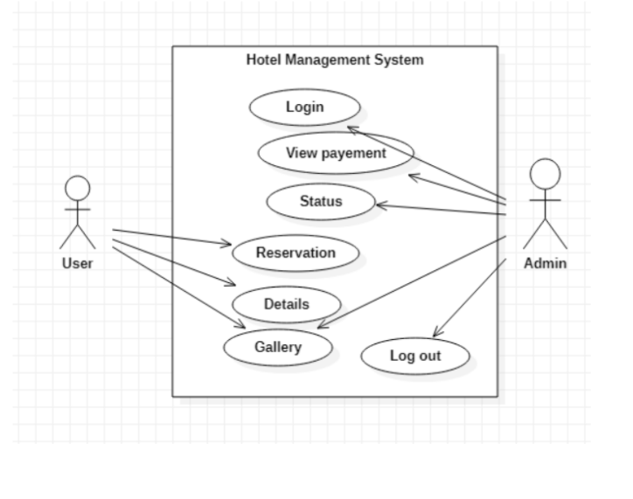
Use case Diagram

Slide 10
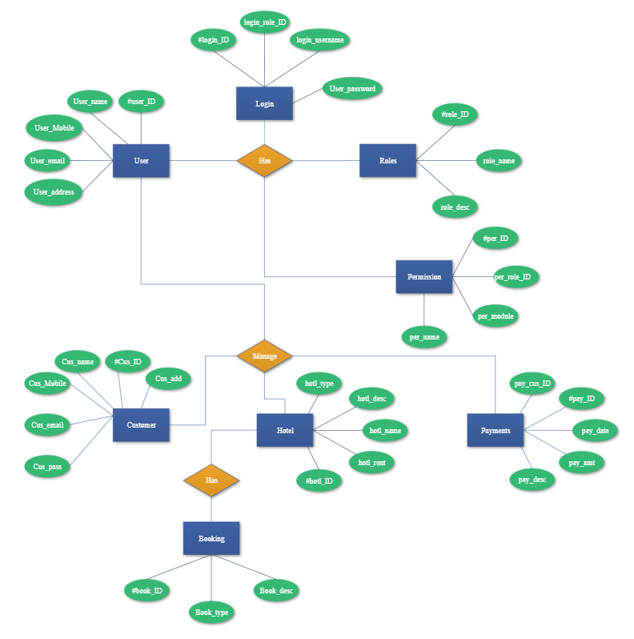
ER DIAGRAM

Slide 11
Advantage
The advantages of booking a hotel online add up long before your arrival. Our legendary customer
service extends to the web
One advantage of booking with the hotel directly is the use of the hotel's full cancellation policy as
well as not needing a deposit in most situations.
Read reviews and compare prices for Online Hotel Booking.
The most important advantage of online hotel booking is convenience, you can book your room by
simply sitting in home. Internet helps you to browse through the hotels around the world and
compare the facilities and rates easily.

Slide 12
Future Work
Car facilities
Restaurant system.
Tourist package and guide system
Meeting and conference facility.

Slide 13
Thank you

